Slide 1
A neighbor’s tick bite and the risk of Lyme
Allah does not feel shy at mentioning the example of even a small insect because of what it carries above it [2:27]
Ilhaam Ahmed Husain
Pittsburgh, PA

Slide 2
Aims
Examine why a tick bite can be a serious issue.
Understand how Lyme Disease is transmitted from a tick.
Assess the risk of Lyme Disease after a tick bite.

Slide 3
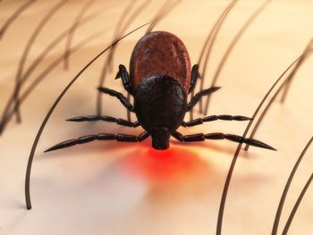
Real life scenario: A frantic neighbor at the door
One fine morning, our neighbor came frantically to our door with a chief complaint:
“A tick is on my arm!”
My father calmly took out his medical bag and, using a pair of forceps, gingerly pulled the tick off while grabbing it close to the skin.
“Thank you. I was so worried,” sighed my neighbor.

Slide 4
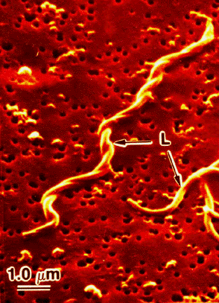
Why was my neighbor so worried about a tick bite? Because of the risk of Lyme Disease
Some ticks carry (and transmit) a bacteria called Borrelia burgdorferi , or B. burgdorferi for short.
B. burgdorferi causes an infection called Lyme Disease.
The most common tick that transmits B. bergdorfera is the Deer tick, also called Ixodes scapularis.
B. burgdorferi seen using an electron microscope.

Slide 5
What type of tick was stuck on my neighbor's arm?
The tick from my neighbor’s arm was about as small as a Dippin Dot.
We fixed it in rubbing alcohol, mounted it with clear nail polish onto a glass slide, and placed a coverslip over it.
Under the microscope, it looked like a non-engorged adult female Deer tick.
Above is the actual Deer tick.

Slide 6
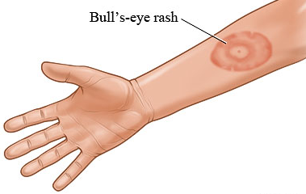
Deer ticks transmit Lyme Disease
Ticks can transmit several infectious diseases
A common infection transmitted by Deer ticks in the Northeastern United States is Lyme Disease
Lyme Disease can cause:
A typical round, red Bull’s-eye rash
Neurological symptoms, such as a facial droop
Joint inflammation, or arthritis, especially of the knees

Slide 7
How do we figure out the likelihood that my neighbor will develop Lyme Disease?
We need look at the facts.
In medicine, a doctor often needs to weigh out the evidence that supports or goes against a particular problem.
Let’s see the body of evidence for or against Lyme Disease transmission.

Slide 8
Reasons to support transmission of Lyme Disease
Pittsburgh, PA
We identified a Deer tick.
Other ticks don’t transmit Lyme Disease
The bacteria B. burdofera lives in (or is endemic to) the Northeastern US (including our home of Pittsburgh)
Areas where infected Deer ticks are found.

Slide 9
Reasons that go against transmission of Lyme Disease
The Deer tick probably came on my neighbor’s arm only about 12 hours prior to being pulled off because she said she was outside gardening the day before.
Deer tick bites lasting less than 36 hours carry low risk of transmission.
Under the microscope, the tick was not engorged.
Lean ticks probably don’t stay on the body long enough to transmit Lyme Disease.

Slide 10
Thus, it is unlikely that my neighbor had transmission of the bacteria causing Lyme Disease

Slide 11
Summary
As per the message from the Holy Quran, even a tiny insect, for example, the size of a deer tick can cause problems.
Deer ticks transmit the bacteria that causes Lyme Disease
Lyme Disease is a serious infection that can lead to neurological problems and arthritis
Medical providers need to assess each tick bit on a case by case basis to know whether it’s likely to lead to Lyme Disease

